Slide 1
Exercise 5 – MIPS ALU
Design a limited functionality MIPS ALU module להוסיף מוצא br_taken לתת שמות פרמטריים לפקודות
in1
32
ALU
in2
result
32
32
Inst C
op
32
4
ALUop

Slide 2
Exercise 5 – MIPS ALU
Design a limited functionality MIPS ALU module.
Design is pure combinational, no clock, no reset.
Implement the following Instructions: Arithmetic: Add immediate, Subtract.
Data Transfer: Load Word, Store Word.
Logical: And, And immediate, Xor, Set on less than, Set on less than immediate.
Add Nop instruction for No Operation state.
Conditional branch: branch if equal, branch in not equal.
Use parameters with instruction names.
Write a Test Bench and verify correct operation.

Slide 3
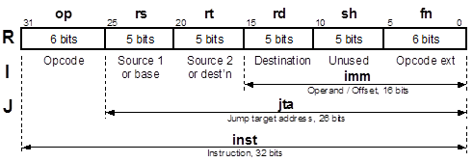
MIPS Instruction Set Architecture (ISA)
I type instructions have opcode, address of 1 operand, address of
destination result and a 16bits Constant (imm).
Imm should be sign extended to 32bits signed number for addi.
Imm should be zero extended to 32bits signed number for ori. Sh – 5bits shift amount for shift operations

Slide 4
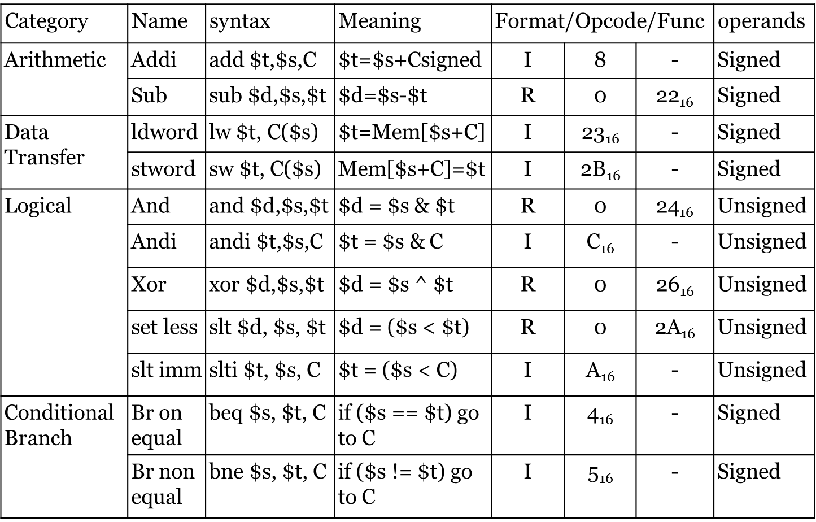
MIPS Instructions Set

Slide 5
MIPS / ALU Instructions
Instructions: // 32bits in3 == sign extended 16bits imm (C) Signed Operations: 1. Addi (arithmetic) : result = in1 + in3 (C) ; 2. Sub (arithmetic) : result = in1 - in2 ;
3. beq (cond. branch): result = in3 (br_adress=C), br_taken
4. bne (cond. branch): result = in3 (br_adress=C), br_taken Unsigned Operations: 5. Lw (data xfer) : result = in1 + in3 ; (Mem addr for read) 6. Sw (data xfer) : result = in1 + in3 ; (Mem addr for write) 7. And (logical): result = in1 & in2 ; 8. Andi (logical) : result = in1 & in3 (C) ; 9. Xor (logical): result = in1 ^ in2 ;
10. slt (logical): result = (in1 < in2) ;
11. slti (logical): result = (in1 < in3) ;

Slide 6
MIPS ALU Design Guidelines
Declare inputs in1, in2 and as signed.
Assign logical values to the 11 ALU operations (ALUop) and a NOP operation. Use parameters with instruction names.
Design ALU as combinational circuit. No clock, no reset.
Use the conditional assignment operator to select the right ALU operation. Assign (op)? … : (op)? … :(op)? … : 32’h0 ;
Make sure that the Logical operations will be performed as unsigned arithmetic. Use the $unsigned function.
In the Test Bench, zero extend the 16bits Constant (immediate) value to 32bits for unsigned operations and sign extend to 32bits for signed operations.
Write a Test Bench and verify correct operation of the ALU, using the zero or signed extended C values.

